Slide 1

“BE FORMED AND FORM”
“बनो और बनाओ “
BATCH - 680

Slide 2

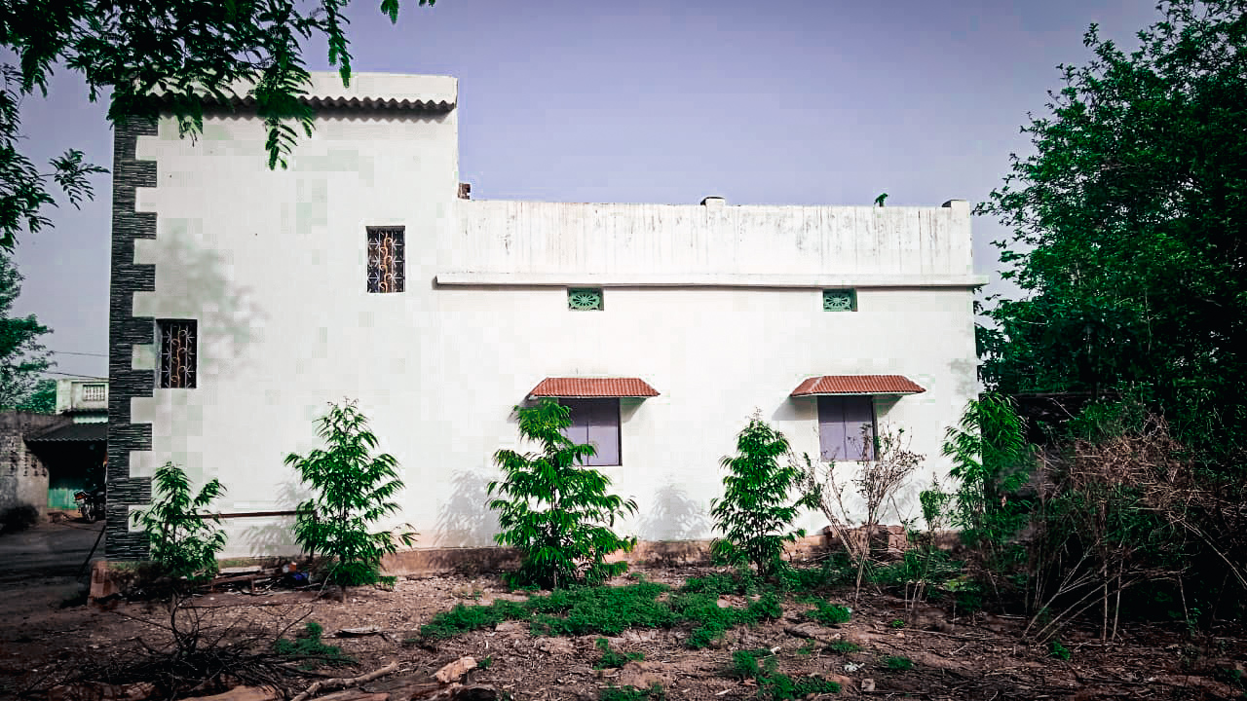
BFF HOUSE jharberna rajgangpur sundargarh Odisha

Slide 3



Slide 4

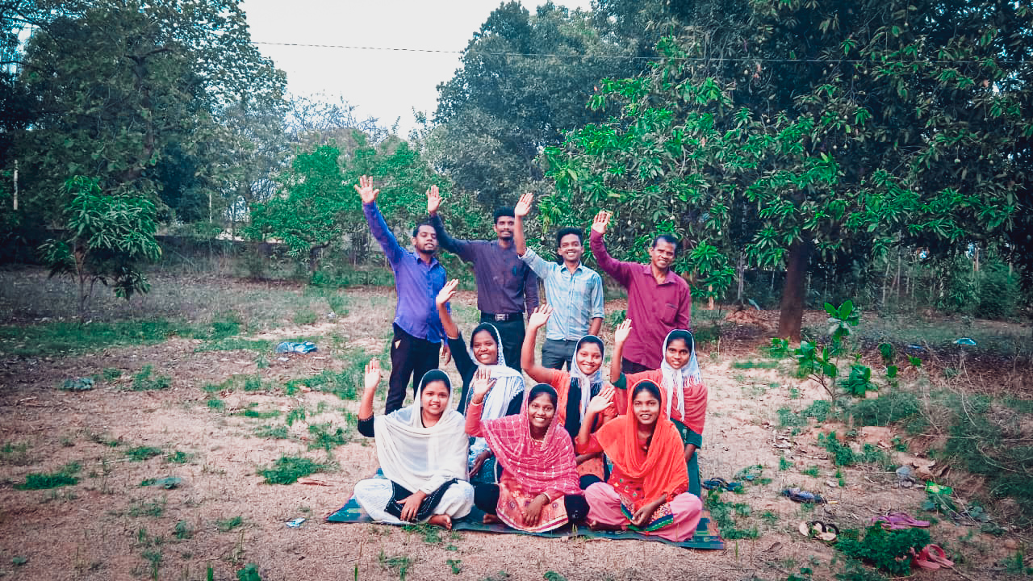
Student with teachers

Slide 5
"बनो और बनाओ "
Be Formed And Form (BFF) Batch - 680
Jharberna,
BFF Centre, rajgangpur ,sundargarh, Odisha
22.05.2022 – 29.05.2022
SOME MEMORABLE EVENTS
(BFF 7 दिनों का प्रशिक्षण )

Slide 6
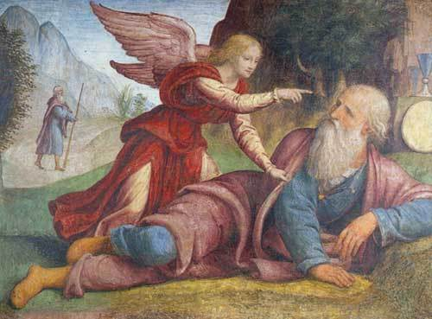

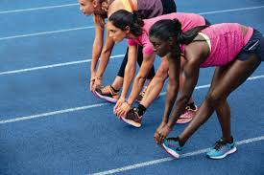
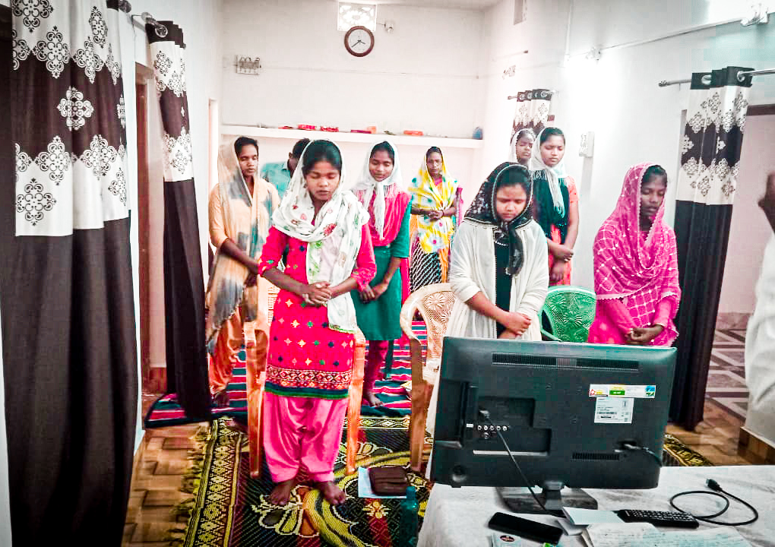
1.BFF-TRAINING WAKES UP THE BELIEVERS WHO ARE ASLEEP LIKE ELIJAH
दूसरी बार यहोवा का दूत आया और उसे छूकर कहा, "उठकर खा, क्योंकि तुझे बहुत लम्बी यात्रा करनी है।"
1 राजाओं 19:7
BFF - MAKES THE TRAINEES TO WALK ON THE PATH OF GOD

Slide 7
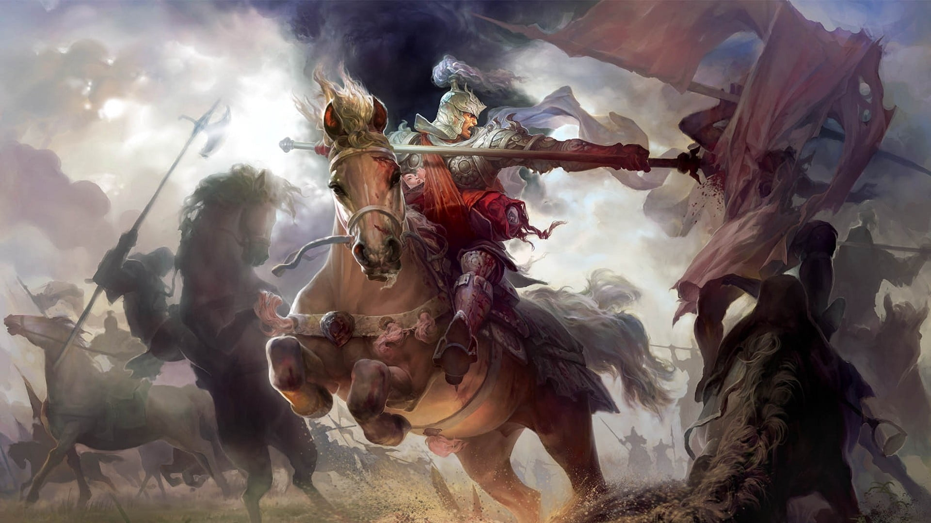
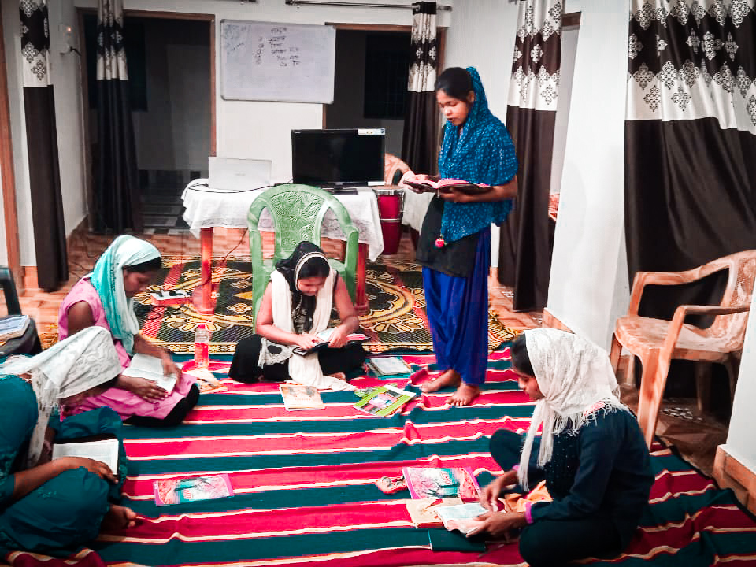
2. BFF – TRAINING RELEASES THE BELIEVERS FROM THE INSTITUTIONAL CHURCH AND MAKES THEM TO CARRY JESUS ALL AROUND THE WORLD, Mat-21:5
और उन्होंने बच्चे को यीशु के पास लाकर उस पर अपने कपड़े डाले और वह उस पर बैठ गया। मरकुस 11: 7)
AFTER THE COMPLETION OF THE TRAINING EACH ONE BECOMES A HILL HORSE

Slide 8
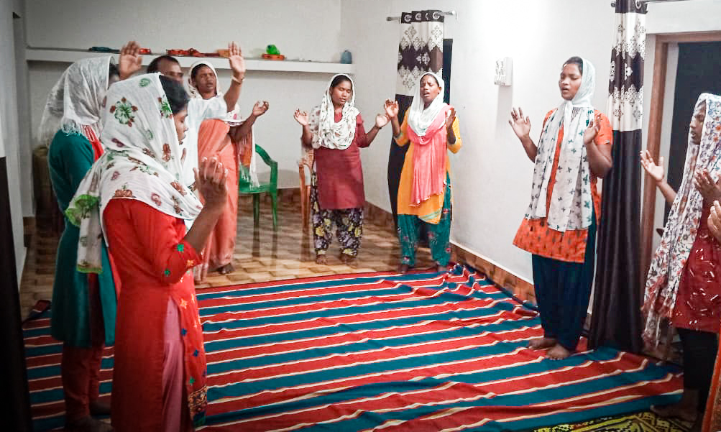
3. BFF
MAKES THEM RECOGNISE THEIR GIFT OF THE HOLY SPIRIT AND REKINDLES THEM.
हे सिय्योन, जाग, जाग! अपना बल धारण कर*; (यशायाह 52:1)
BFF HELPS THEM MAKE USE OF THESE GIFTS IN THEIR WORK PLACE AND BRING PEOPLE INTO LIGHT.

Slide 9
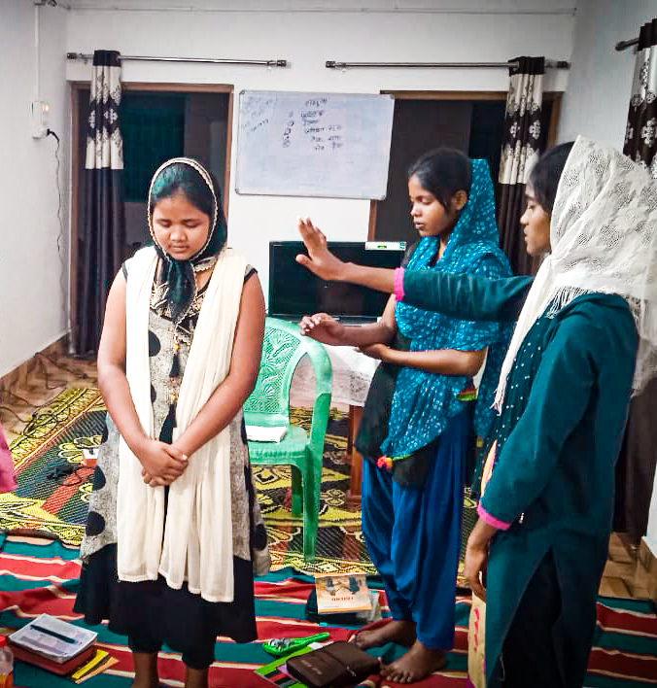
4. BFF प्रशिक्षण विश्वासियों के जीवन को दर्शन से भरता है।
पर उस पदार्थ को पकड़ने के लिये दौड़ा चला जाता हूँ, जिसके लिये मसीह यीशु ने मुझे पकड़ा था। फिलिप्पियों 3:12
देश के निमित्त नाके में खड़े होकर देश केलिए प्रार्थना करते हैं।

Slide 10
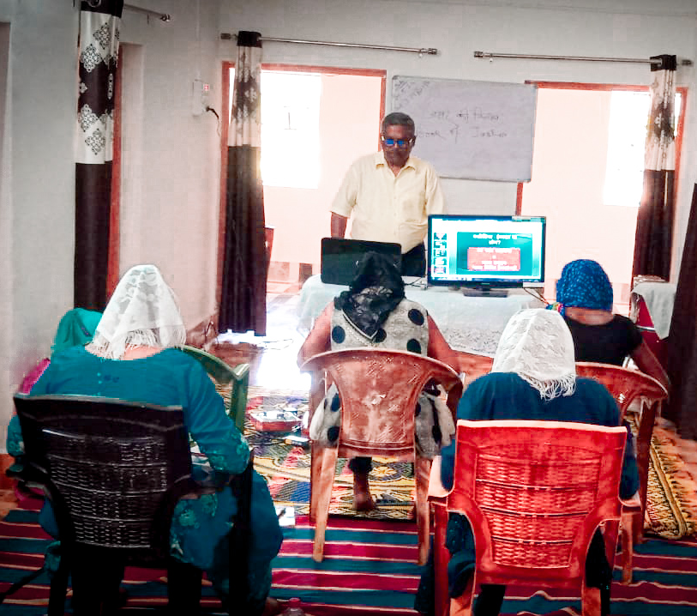
“‘In the last days, God says,
I will pour out my Spirit on all people.
Your sons and daughters will prophesy,
your young men will see visions,
your old men will dream dreams.. ACTS 2:17

Slide 11

5. BFF HELPS US TO KNOW THE WILL OF GOD AND WORK ACCORDINGLY
Preach the word; be prepared in season and out of season; correct, rebuke and encourage—with great patience and careful instruction 2Tim 4:2
BFF TRAINEES RUN WITH A SPECIFIC GOAL IN LIFE.

Slide 12
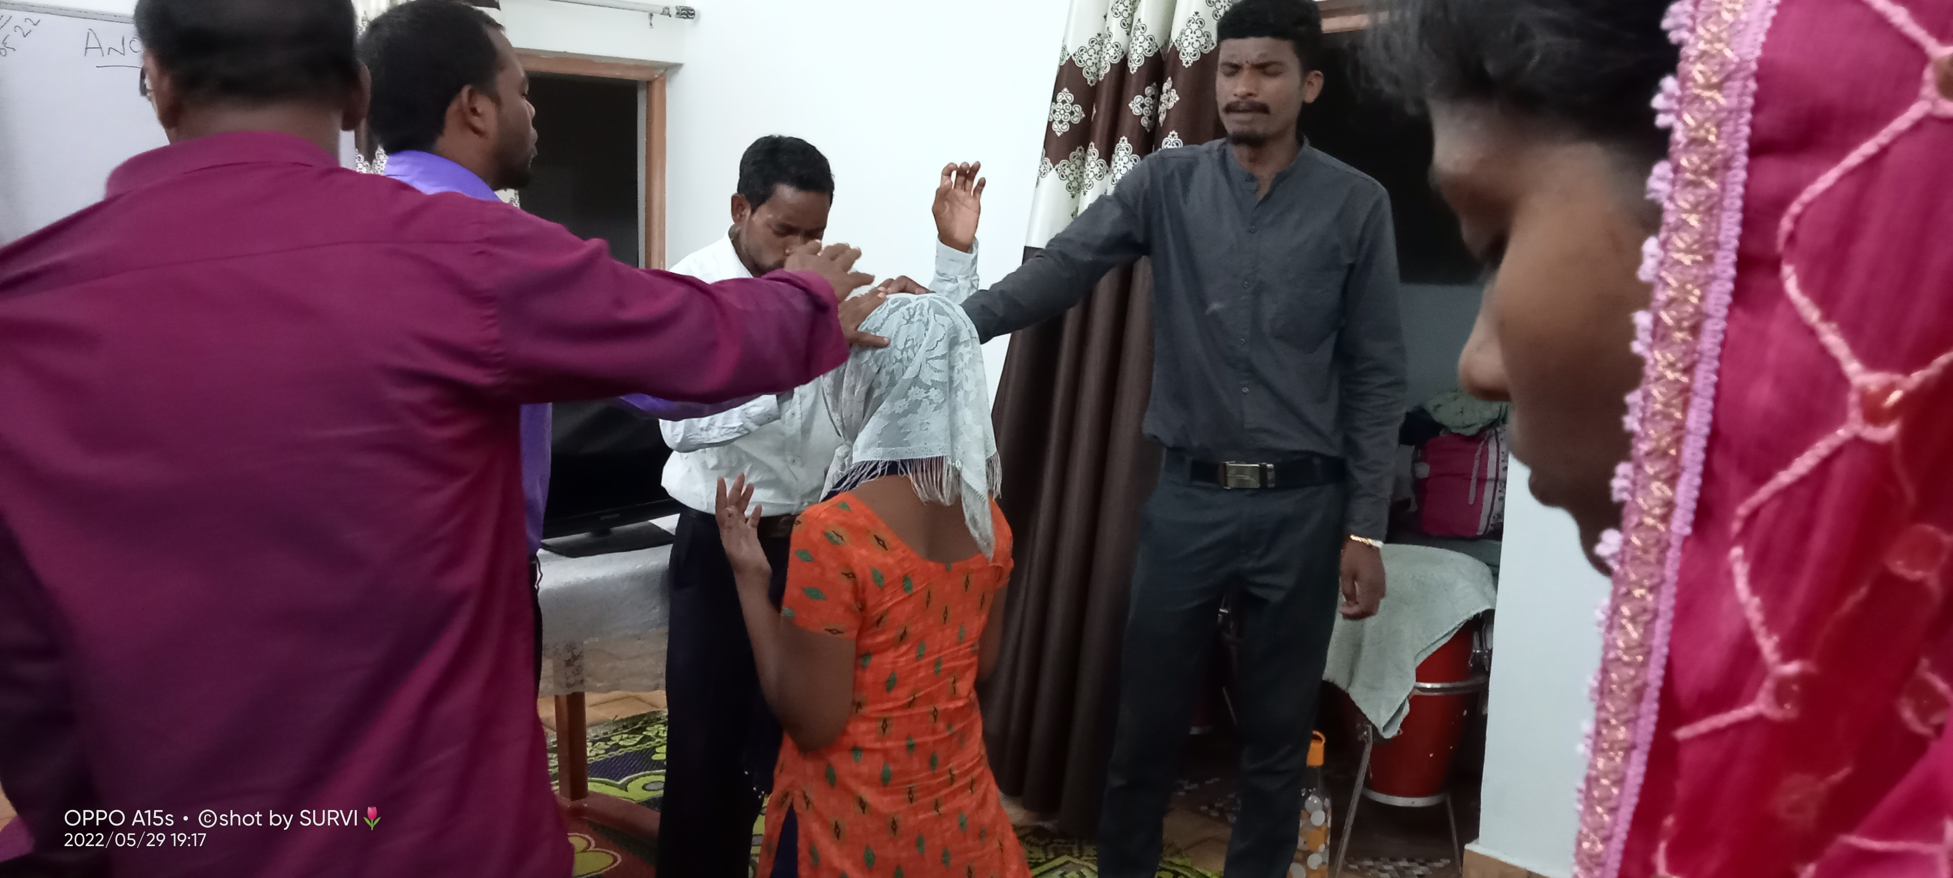
7BILIVERS FROM ODISHA PARTICIPATED IN THE BFF, BATCH - 680

Slide 13
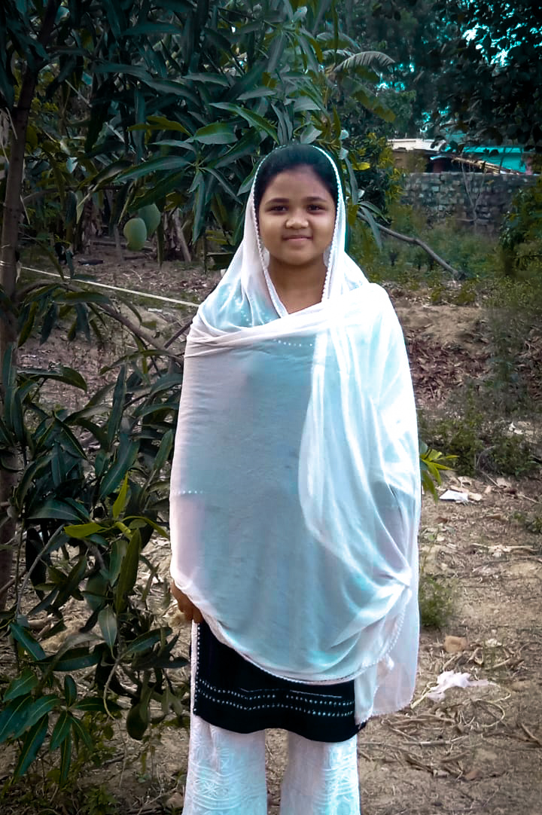

Amisha ekka
Surovi Lakra

Slide 14


Suchita Panna
Puja Toppo

Slide 15


Anju xaxa
Abhijeet ekka

Slide 16
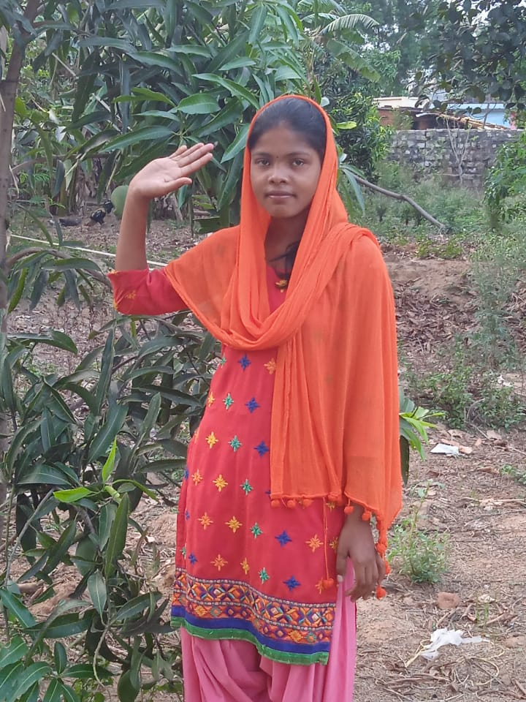
Sarita dang

Slide 17
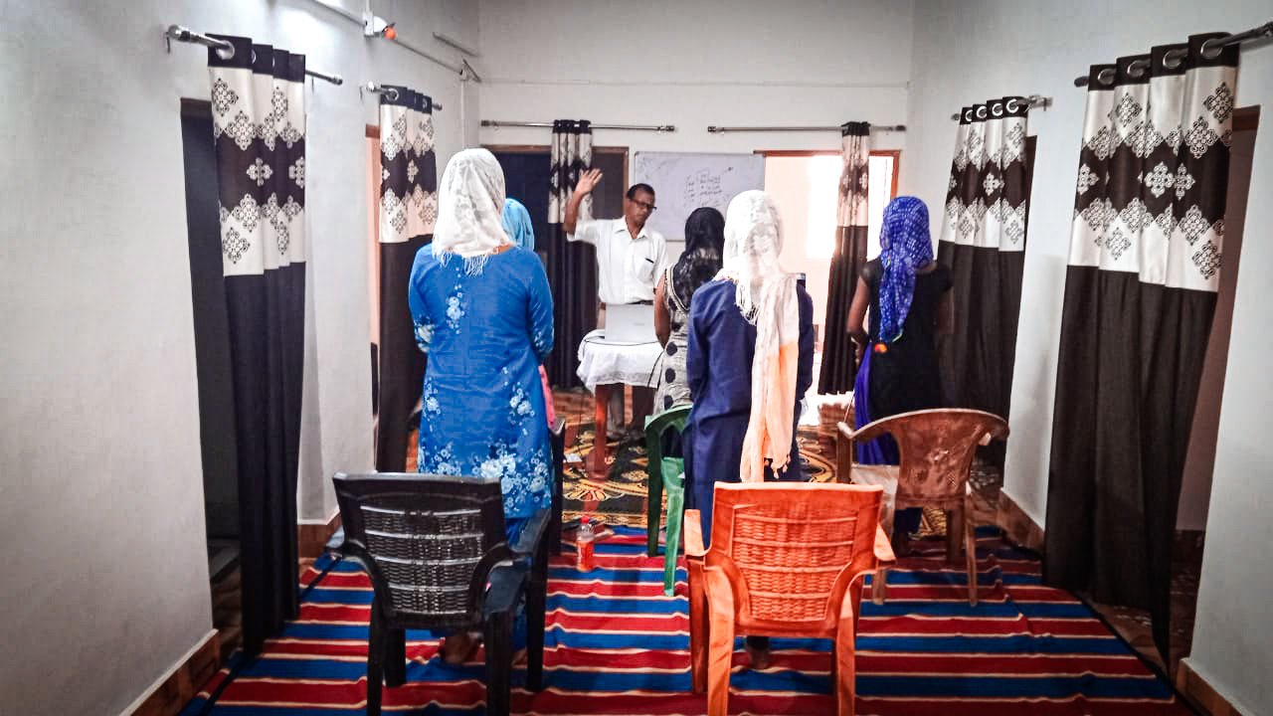

6. BFF TRANSFORMS AN ORDINARY BELIEVER INTO A WARRIOR
“Join with me in suffering, like a good soldier of Christ Jesus.” (2Timo2: 3)
The Lord Almighty is mustering an army for war.(Isa 13 :4)

Slide 18
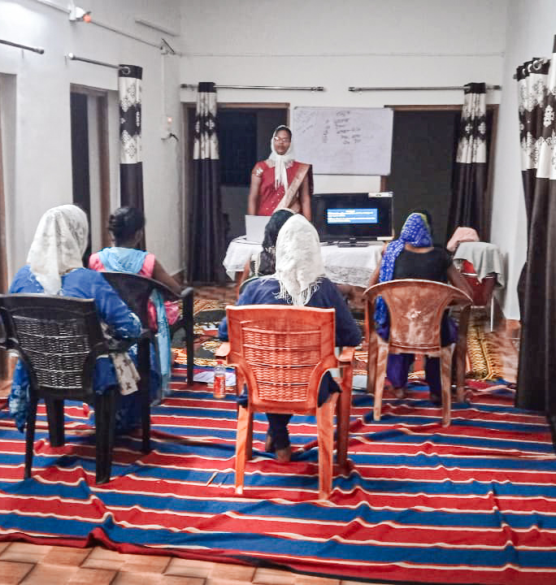
7. BFF TRAINING MAKES THE TRAINEES UNDERSTAND THEIR GOD GIVEN RESPONSIBILITY ON THE EARTH
Guard the good deposit that was entrusted to you—guard it with the help of the Holy Spirit who lives in us. 2Timo 1:14
Well done, good and faithful servant! You have been faithful with a few things; I will put you in charge of many things. Come and share your master’s happiness!’; (Mat- 25: 21)

Slide 19
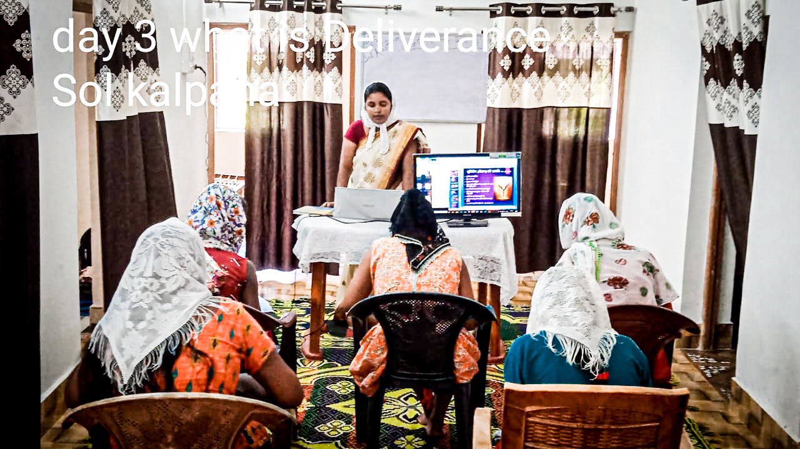
8. BFF BRINGS A TURNING POINT IN EVERYONE’S LIFE.
God changed Saul’s heart, 1Sam 10: 9)
you will prophesy with them; and you will be changed into a different person.. (1 Sam 10: 6)

Slide 20
DIGNITY OF WORK – BFF- TRAINING HELPS THE TRAINEES TO EXPRESS THEIR LOVE THROUGH WORK.
THEY INVOLVE IN ALL TYPES OF WORK.

Slide 21
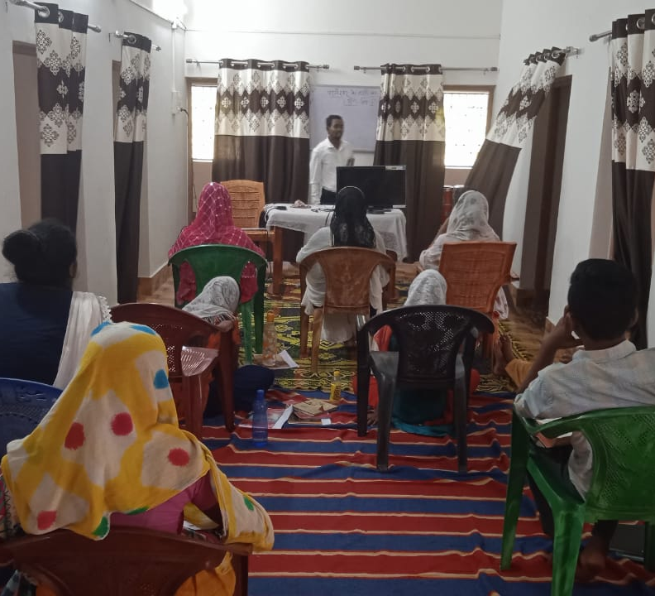


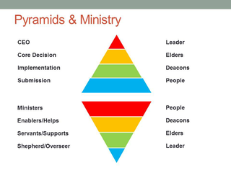
9. BFF TRAINING GIVES A NEW PERSPECTIVE TO A BELIEVER
“Set up the tabernacle according to the plan shown you on the mountain. Exo 26:30
The glory of this present house will be greater than the glory of the former house,’ says the Lord Almighty. ‘And in this place I will grant peace,’ declares the Lord Almighty.”) Haggai 2:9
NEW MODEL
OLD MODEL

Slide 22
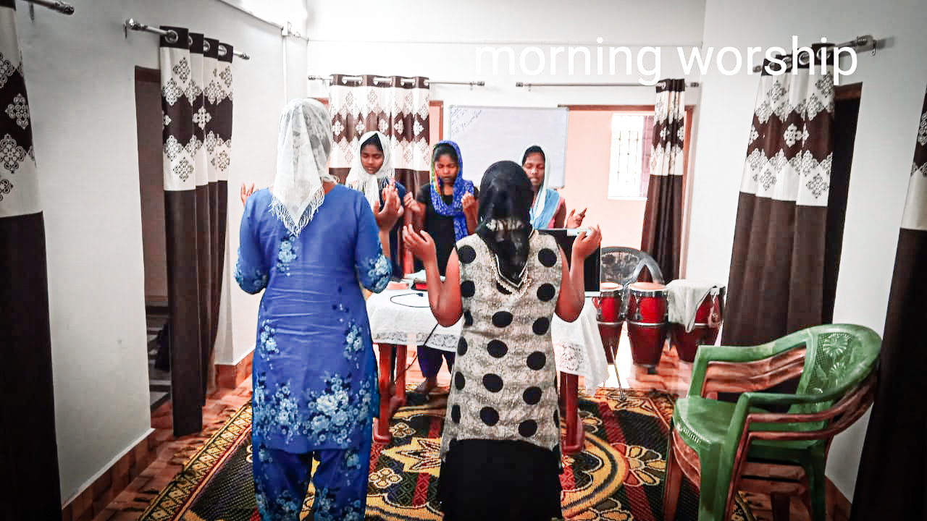
10. BFF TRAINING REMINDS THEM THAT THEY ARE A ROYAL PRIESTHOOD, A HOLY NATION, GOD’S SPECIAL POSSESSION.
I thank Christ Jesus our Lord, who has given me strength, that he considered me trustworthy, appointing me to his service. 1Timo 1:12
BFF THOSE WHO HAVE COMPLETED THE TRAINING THEY WORK AS TEACHERS, TROOP CHURCH LEADERS AND PRIESTS, AND CARRY FORWARD THEIR MINISTRY

Slide 23
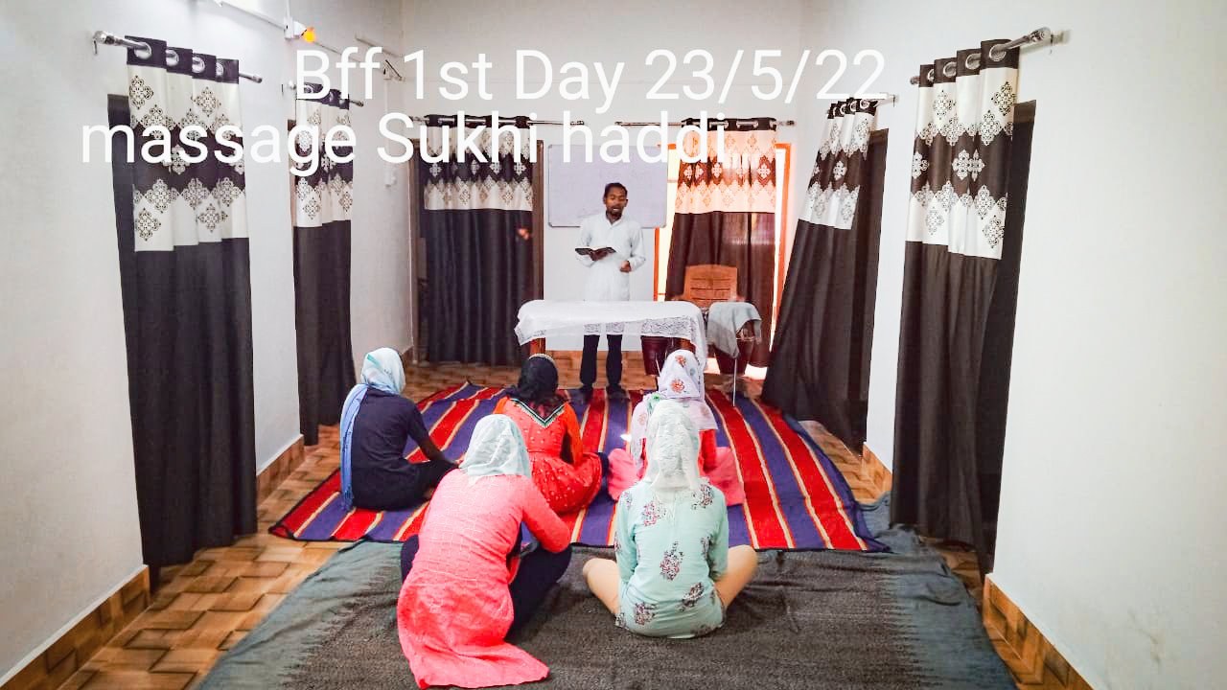
THEY LEARN TO WORSHIP THE LORD IN TRUTH AND SPIRIT
Jn 4:21
WORSHIPPING GOD IN THE BEAUTY OF HIS HOLINESS

Slide 24
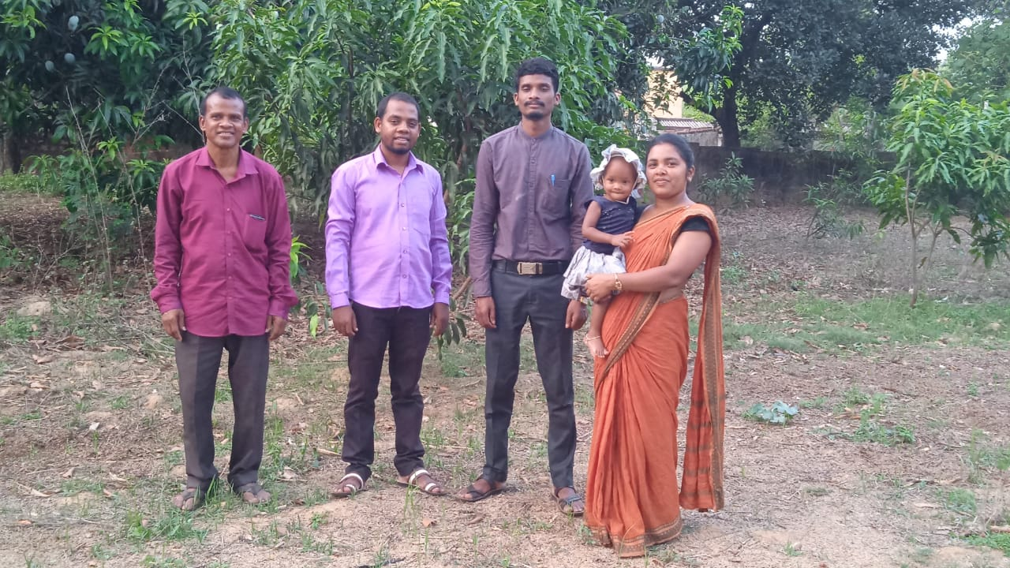
Managing Staff

Slide 25
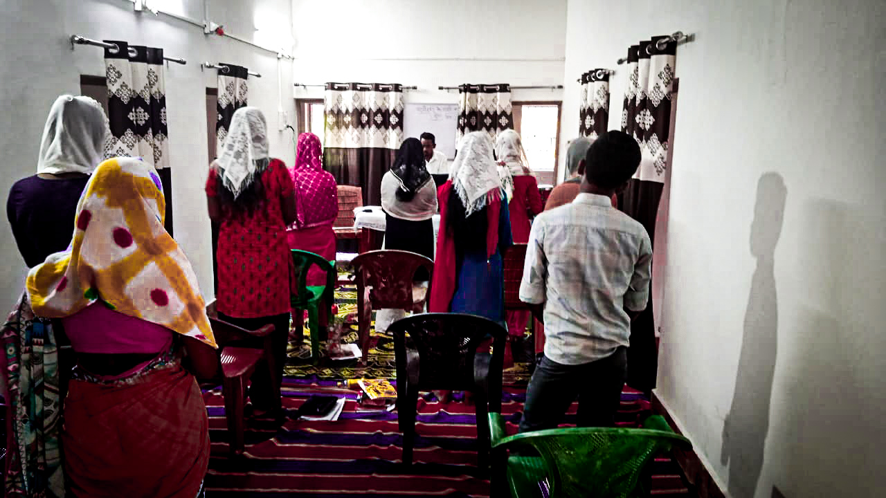
पवित्र एशियाई की दिव्य उपस्थिति और स्पर्श का अनुभव करने के लिए यह गौरव का समय है। राष्ट्र पर भविष्यवाणी!

Slide 26
BFF - LESSONS
DISPENSATIONAL PLAN OF GOD – 30 STEPS PART I&II (1-15)
AGE OF GRACE
ENHF VISION ABOUT INDIA
MODEL CHURCH, OPERATIONAL ECCLESIA &7FOLD AGENDA
HUMAN GOVERNMENT – BEGININNING, GROWTH AND END OF IDOL WORSHIP
KNOW YOUR ENEMY – ADAM TO NIMROD – MYSTERY RELIGION
SHEKINAH GLORY – INDWELLING OF THE HOLY SPIRIT IN HUMAN BEING
STORAGE OF SEEDS
EVANGELISM THROUGH BUSINESS

Slide 27
SPECIAL CLASSES
Deliverance and Practical
Healing and Practical
Prophecy and Practical

Slide 28
BFF - TIME TABLE
Rising - 4:45:00 AM Tea - 5:15 – 5:300 AM Morning Devotion - 5:30 – 7:30 AM Group work & Personal Work -7:30 – 8:30 AM Breakfast - 8:30 – 8:45 AM Class 1 - 08:45 – 10:15 AM Tea break - 10.15 – 10:30 AM Class 2 - 10:30 – 12:00 AM Class 3 - 12:00 – 01:30 PM Lunch - 01:30 – 02:00 PM | Class 4 - 02:00 - 03:30 PM Break - 03:30 – 03:45 PM Class 5 - 03:45 – 05:15 PM Tea Break -05:15 – 05:30 PM Class 6 - 05:30 – 07:00 PM Troop Church Meeting - 07:00 – 08:30 PM Dinner - 08.30 – 09:00 PM Sharing Time - 09:00 – 09:30 PM Personal Prayer - 09:30 – 10:00 PM To bed – 10:00 PM

Slide 29
BFF 680 ALL THE 7 BELIEVERS ARE TRANSFORMED INTO HILL HORSES
THEY HAVE BECOME SMPs & SMLAs to SHATTER THE STRONGHOLDS OF SATAN IN ODISHA

Slide 30
Teachers of BFF batch 680
1 | Sol J M barla
2 | Sol. Tulika
3 | Sol. Yeshumilan
4 | Sol. Mihir
5 | Sol. Kalpana
6 | Sol. Malita
7 | Sol. Fhulo
8 | Sol. Seema
9 | Sol. Birendra
10 | Sol.bilashi
11 | So.sunita
12 | So.survi
13 | Sol Manohar

Slide 31
BFF participants inherited the following areas
S.No | Name
1 | Suchita Panna
2 | Amisha ekka
3 | Puja Toppo
4 | Sarita dang
5 | Anju xaxa
6 | Sûrvî lakra
7 | Abhijeet ekka
15 | Sona Panwar | 7830876571 | Dhanolti

Slide 32

India
The land becomes
the Lord’s
India

Slide 33
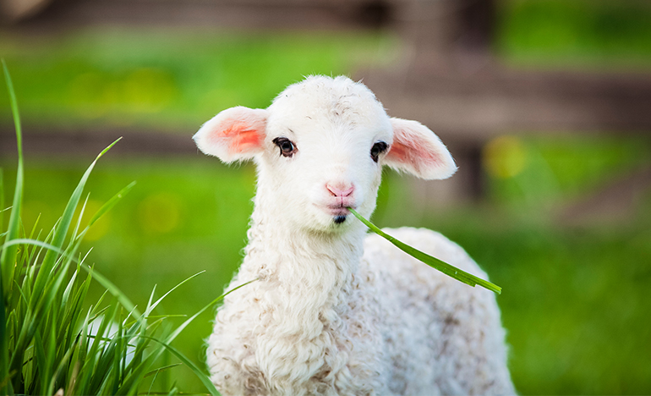
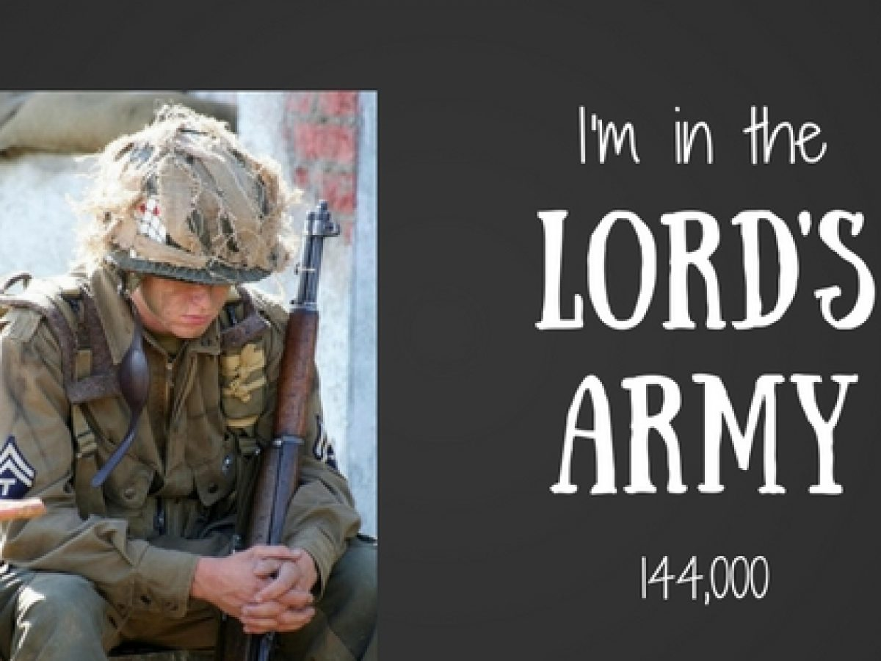
Thank you
All glory to Jesus, We thank all the Teachers & Helpers and prayer warriors who cooperated with this vision.

